Slide 1
Satellite in 5G: Opportunities & Challenges
Gerry Collins | Intelsat, Networks
17th June, 2020

Slide 2
Opportunity: 5G Ecosystem
Software Defined Networking
HAPs
Multi-Access Edge Computing
Virtualization
Massive MiMo
IoT
mmWave
OpenRAN

Slide 3
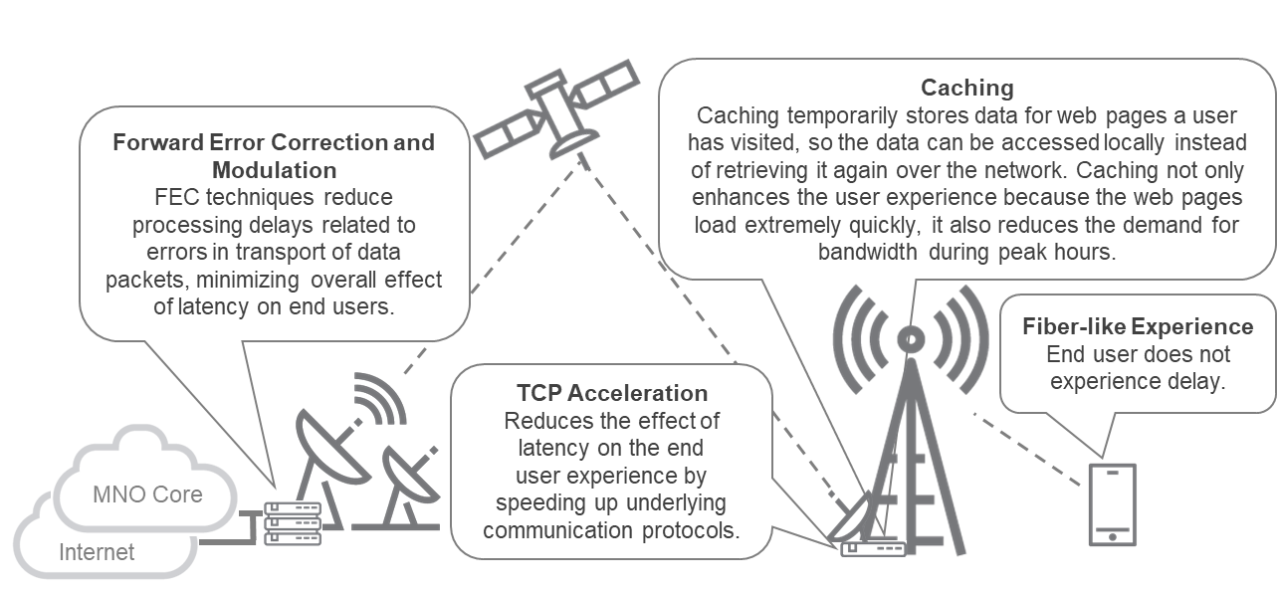
Challenge: 5G Backhaul over Satellite
Latency
Satellite industry believes it gets resolved by lower satellites, but the terrestrial world has yet to be convinced. Target of sub-10ms can only be achieved with combination of satcoms & terrestrial
Ground Systems
With high density spot beams on software defined satellites, ground infrastructure face scaling challenges
End user Experience
Must be better than 4G, 1Gbps
Edge Computing
Required for Latency mitigation, end user experience & improved economics
Notes:
While we cannot eliminate latency due to the laws of physics, we can minimize the impact of that latency on the user experience.
Forward Error Correction, TCP Acceleration, and Caching are all techniques used to optimize throughput performance over satellite connections, improving overall data speed while minimizing latency effects caused by processing delays, resulting in a fiber-like experience for end users.

Slide 4
Thank You

